Slide 1
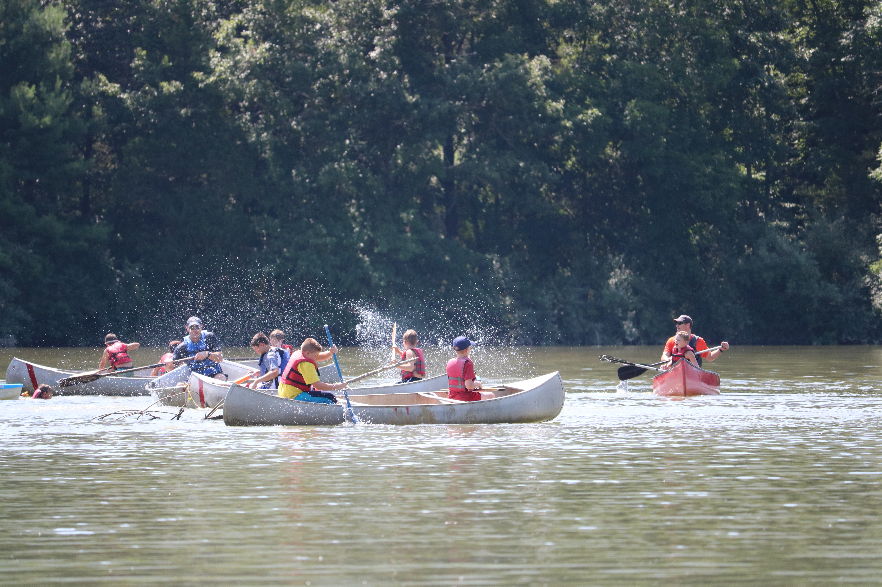

Camp Ross, Goshen Scout Reservation
Summer Camp for Rising Webelos and Arrow of Light Scouts
Notes:
Presenter: Hello everyone! My name is _____________ and I am here to invite to you to join our Den this summer at Camp Ross, a Cub Scout Summer Camp just for rising Webelos and Arrow of Light Scouts (that means you)! This summer, you have the chance to explore the great outdoors, participate in new activities, an learn new skills!

Slide 2
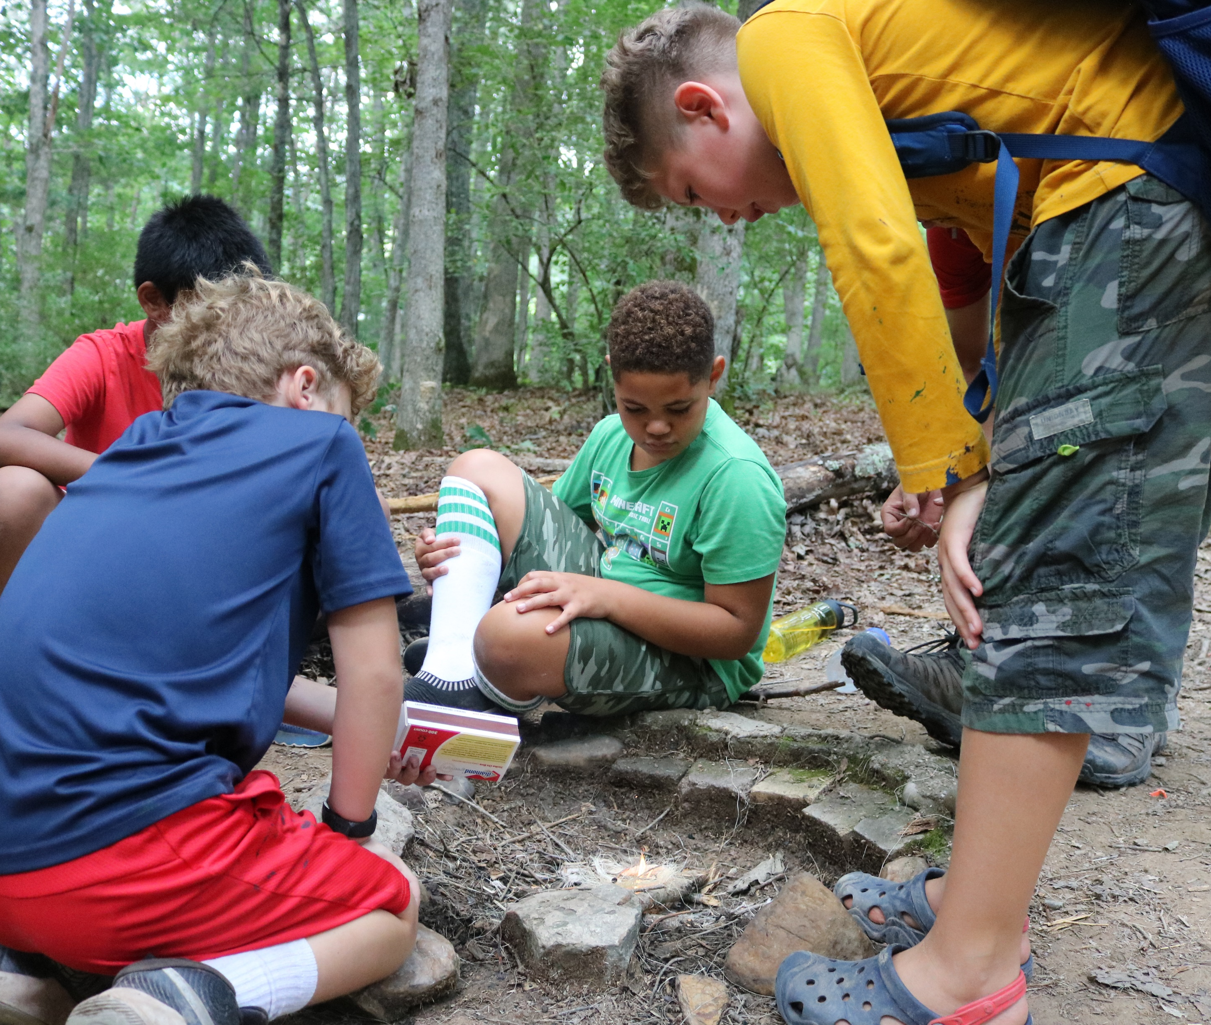

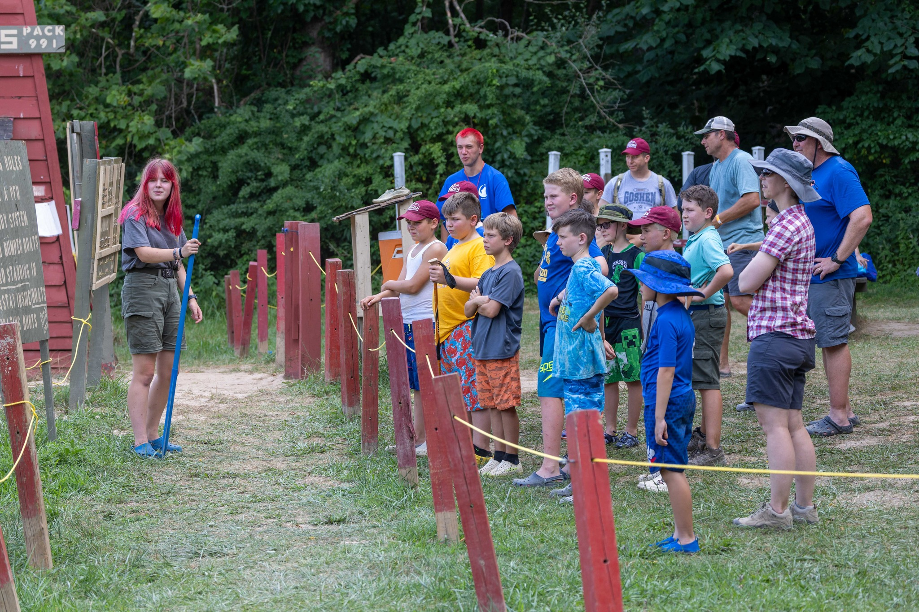
Camp Ross
Week-long Camping Experience
  Sunday - Saturday
Located at the Goshen Scout Reservation (Goshen, VA)
  Approx. 3 hrs. South of Nation’s Capital
Who Should Attend?
  Rising Webelos and Arrow of Light Scouts
  Pack Leadership
  Parents/Guardians
Notes:
Camp Ross is a week-long summer camp experience located at the Goshen Scout Reservation.
The Goshen Scout Reservation is one National Capital Area Council’s camp properties, located approximately 3 hours south of the Nation’s Capital in Goshen, Virginia. Goshen Scout Reservation is home to 5 Resident Camps, one of which, Camp Ross, is specifically for rising Webelos and Arrow of Light Scouts.
Who Should Attend?
Scouts who are entering 4th or 5th grade in the fall (current Bear and Webelo Scouts), Pack Leadership, and Parents / Guardians should attend Camp Ross.

Slide 3
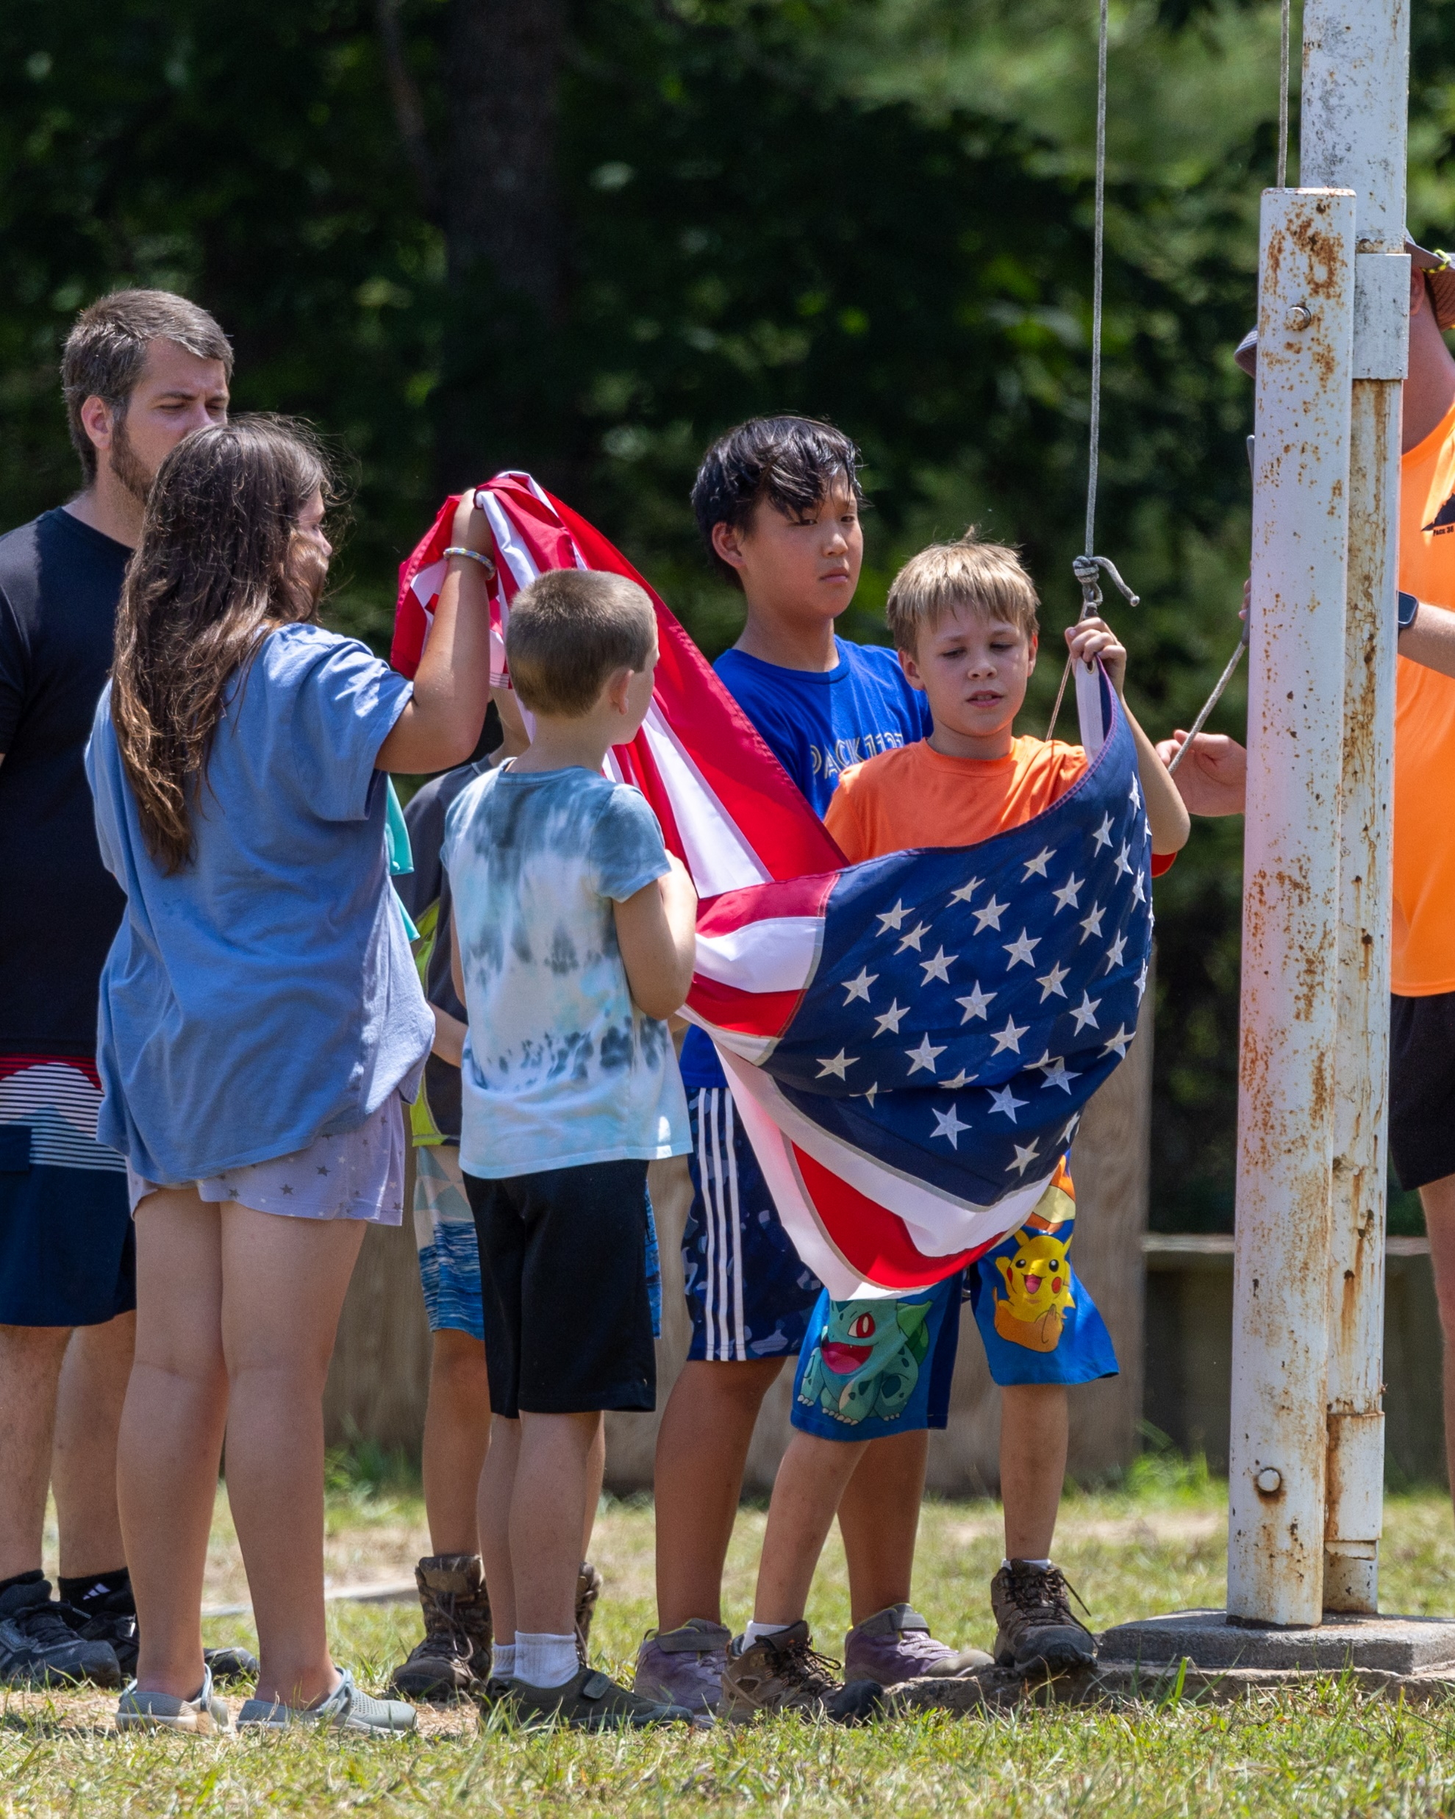
What does Camp Ross Do?
Prepares Scouts for the next step of their Scouting experience – Scouts BSA!
  Social Skills Development
    Leadership
    Communication
    Participation
  Teaches Self-Respect and Character Building
    Responsibility
    Resourcefulness
    Resilience
  Creates a Community Environment
Notes:
Camp Ross prepares Webelos and Arrow of Light Scouts for the next step in their Scouting experience – Scouts BSA!
Through fun, adventure, exploration, and advancement opportunities, Camp Ross provides a platform for Social Skills Development (leadership, communication, participation in group activities), curates experiences that build character (responsibility, resourcefulness, resilience), and creates a unique community environment where Scouts continue to live and abide by the Scout Oath and Law.

Slide 4
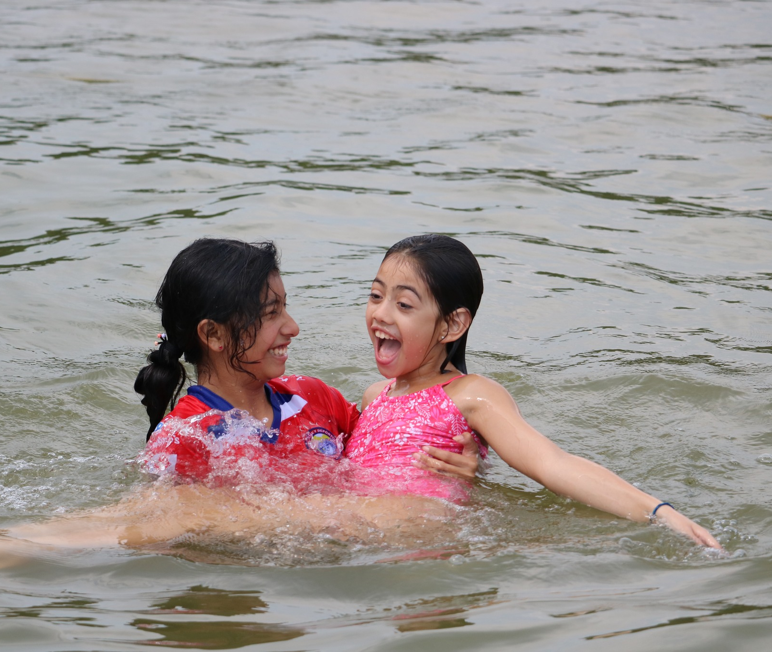
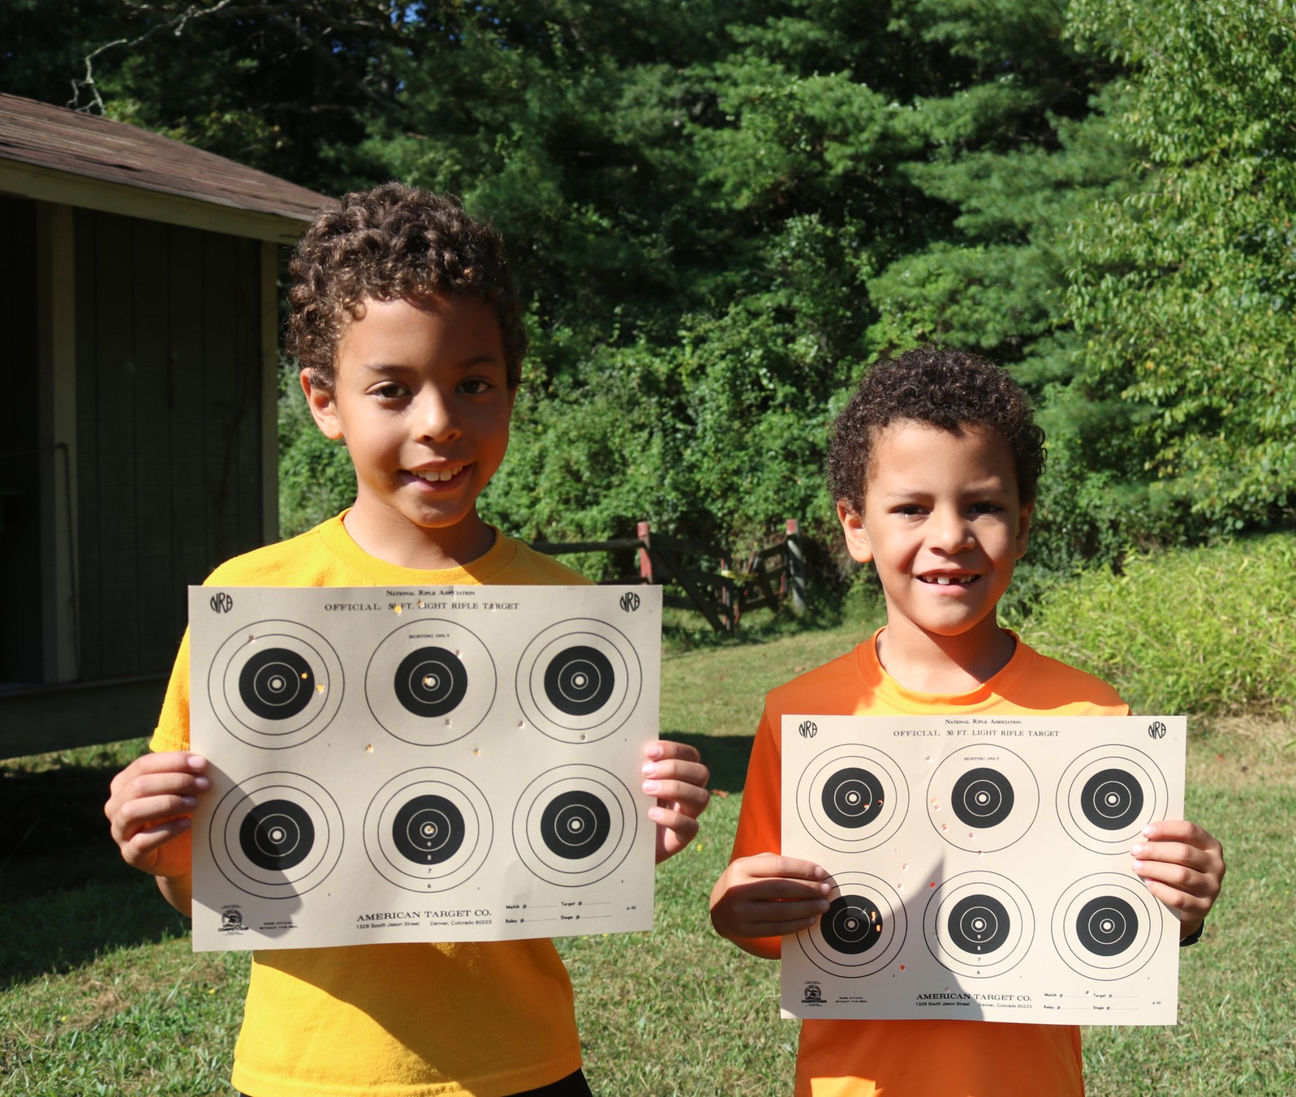
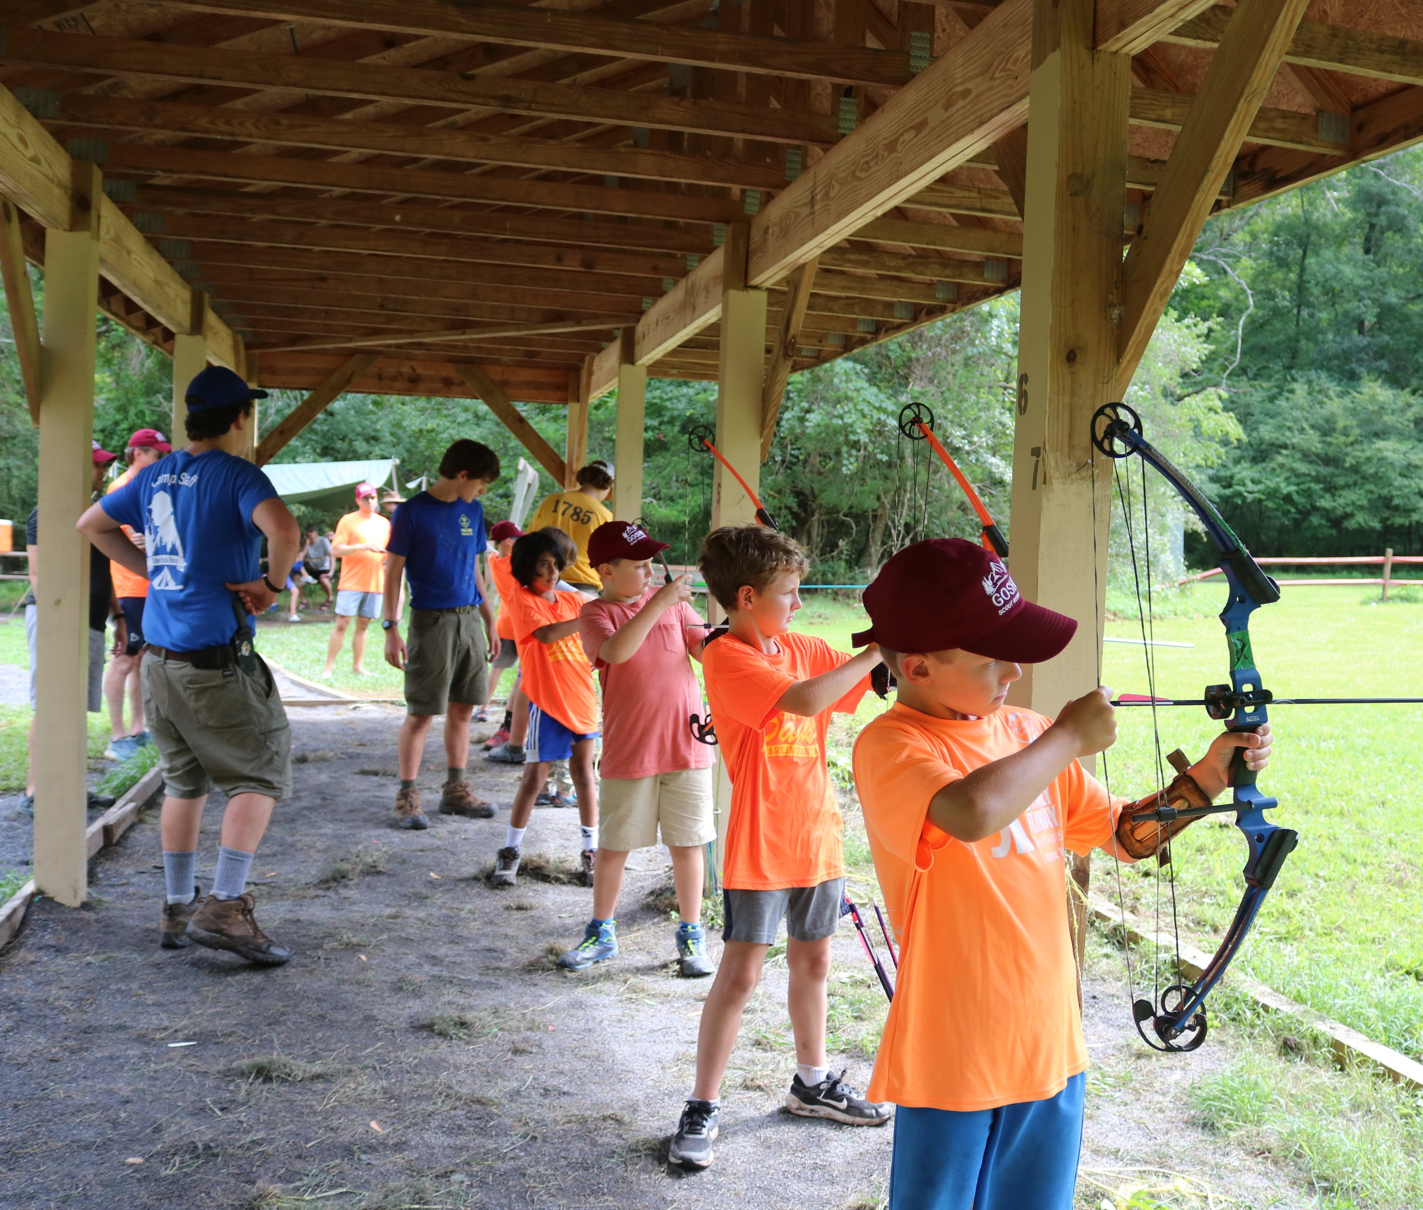
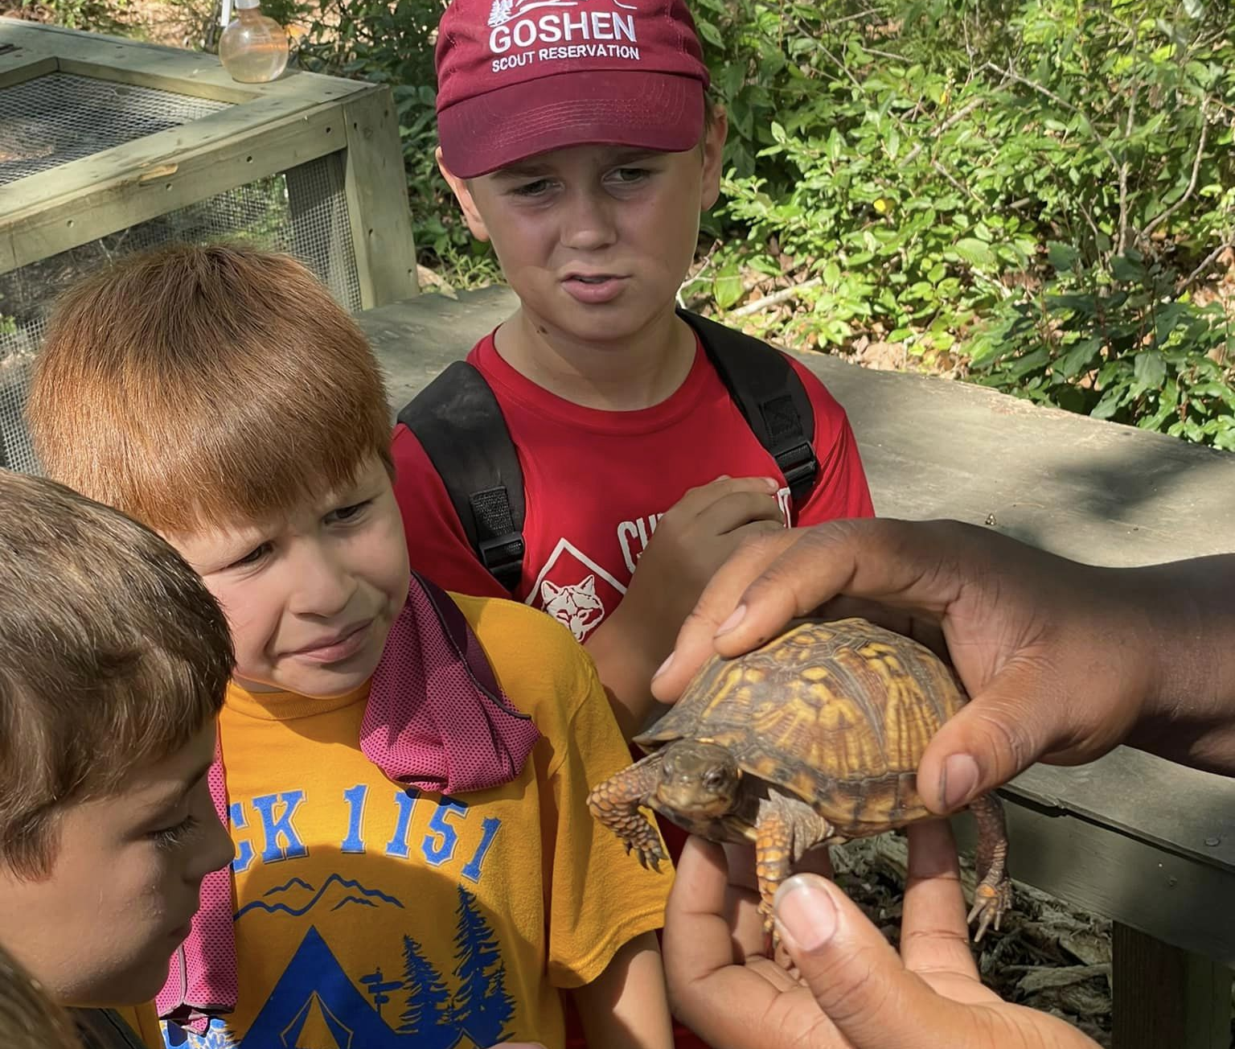
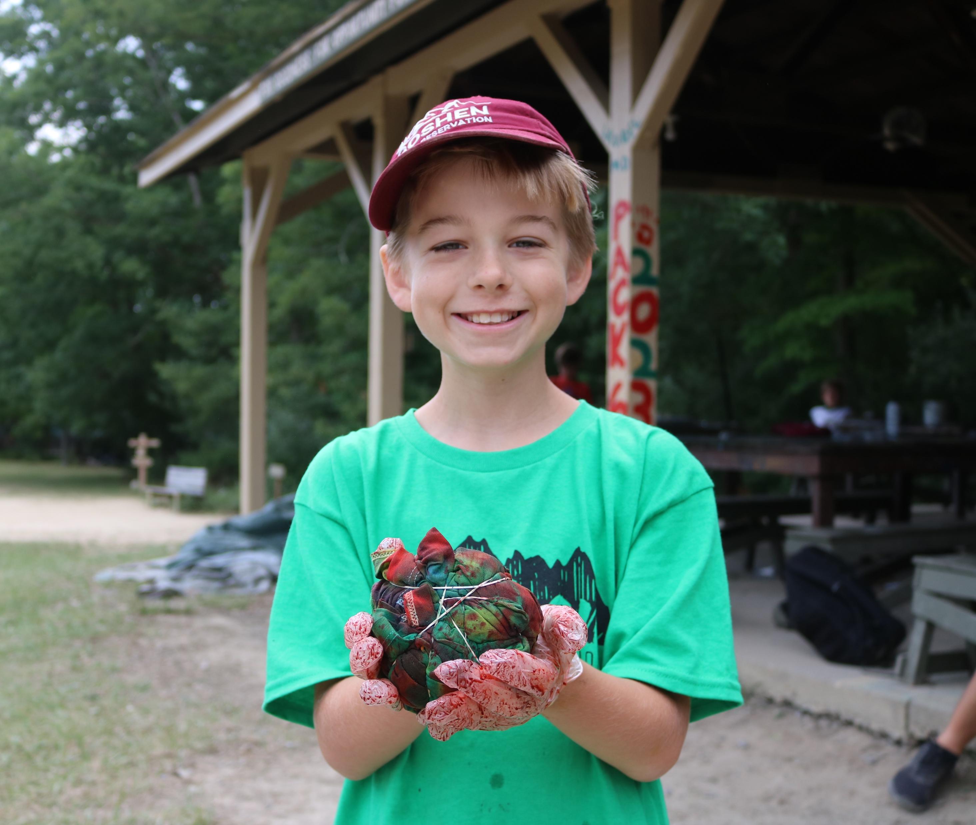
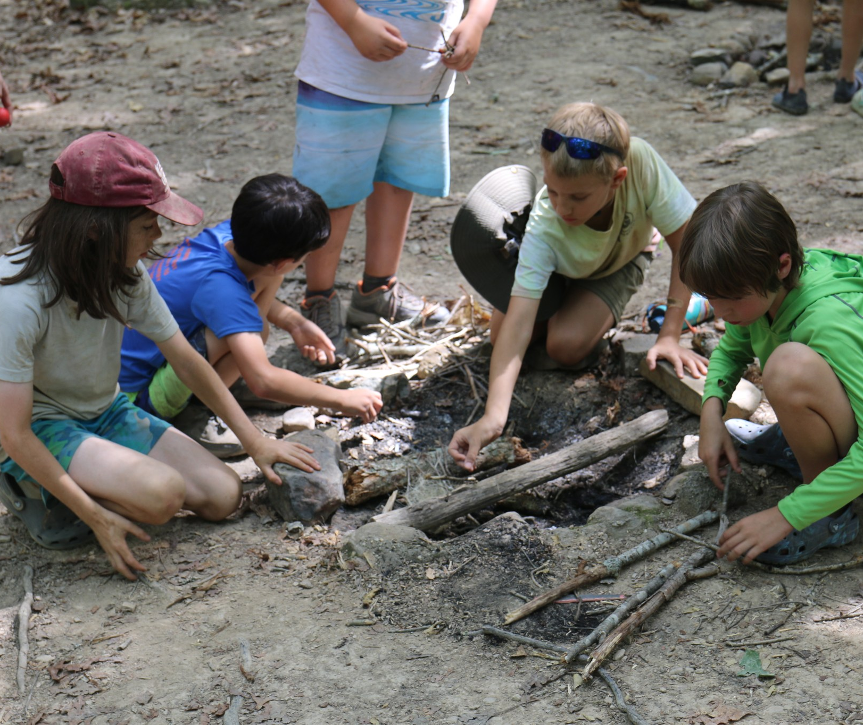
Aquatics
BBs
Archery
Nature
Handicraft
Scoutcraft
Notes:
Presenter: There are so many exciting activities and programs you can do at Camp Ross! You can go swimming and boating at Aquatics, shoot Bows and Arrows at Archery and BB Guns, Turtle Race at Nature, Tie Dye at Handicraft, and practice scout skills at Scoutcraft! Raise your hand if you see something that you are excited to do at Camp Ross.
These are just a few of the programs you can do at Camp Ross. Others include hiking, fishing, team building, service projects, and gaga ball.

Slide 5
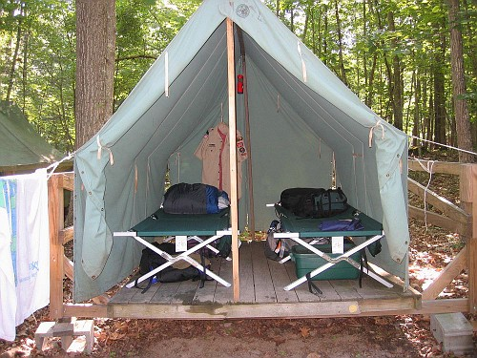
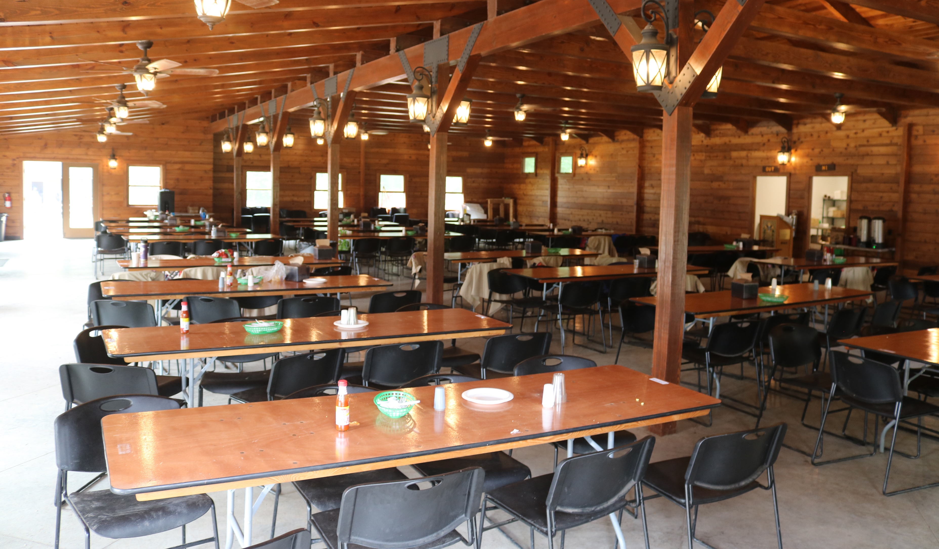
Your Campsite
Where do I sleep?
Canvas Tents
Shared Campsite
How are the facilities?
In-Campsite Latrines
Shower House w/ Flush Toilets
Indoor Modern Dining Hall
Trading Post
Notes:
Where do you sleep? At Camp Ross, all campers (scouts and adults) sleep in a Canvas tent on a wooden platform. All tents provided at Camp Ross come with two cots. Each campsite has a campfire for us to roast marshmallows over,
Parents, I’m sure you’re wondering what the facilities are like. I’m happy to tell you that Camp Ross has a modern Dining Hall, Leader’s Lounge and Pavilion with Fiberoptic Internet, and shower house with single stalls and flush toilets. There’s even a Trading Post that sells apparel, souvenirs, basic camping essentials, snacks, ice cream and slushies,.

Slide 6
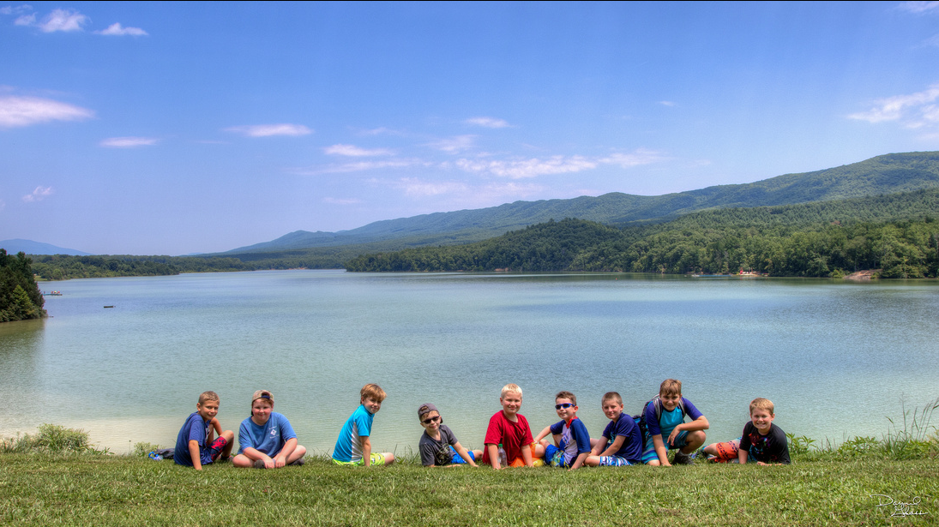
Join us at Camp Ross!
Notes:
Presenter: Our Pack is planning on attending Camp Ross during the (insert Week attending), which is from (insert dates of session).
Summer Camp at Camp Ross will cost $___________. This includes a full week of program, food, and professional staff. Camperships (Financial Aid) is available through an application for up to 50% of the cost of camp.
Review how to register: (Registration suggestion: Create a sign up sheet with names of youth and adults who are interested in attending.)
At this time, we are accepting names of scouts and adults who are interested in attending Camp Ross with the Pack this summer. We hope that you’ll join us for an incredible summer adventure!

